Slide 1
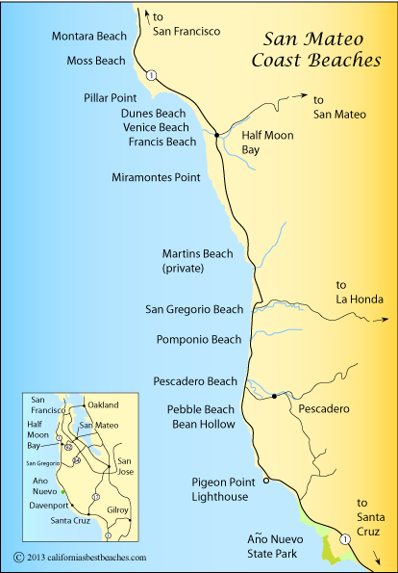
David Cosgrave
Battalion Chief
Coastside Fire Fire Protection District
CalFire- Santa Cruz -San Mateo
Coastside CERT Branch 1 & 2
Listos
34,000 Night time population
Challenges:
Access
Availability of installers
Liability
Documentation/Reporting

Slide 2
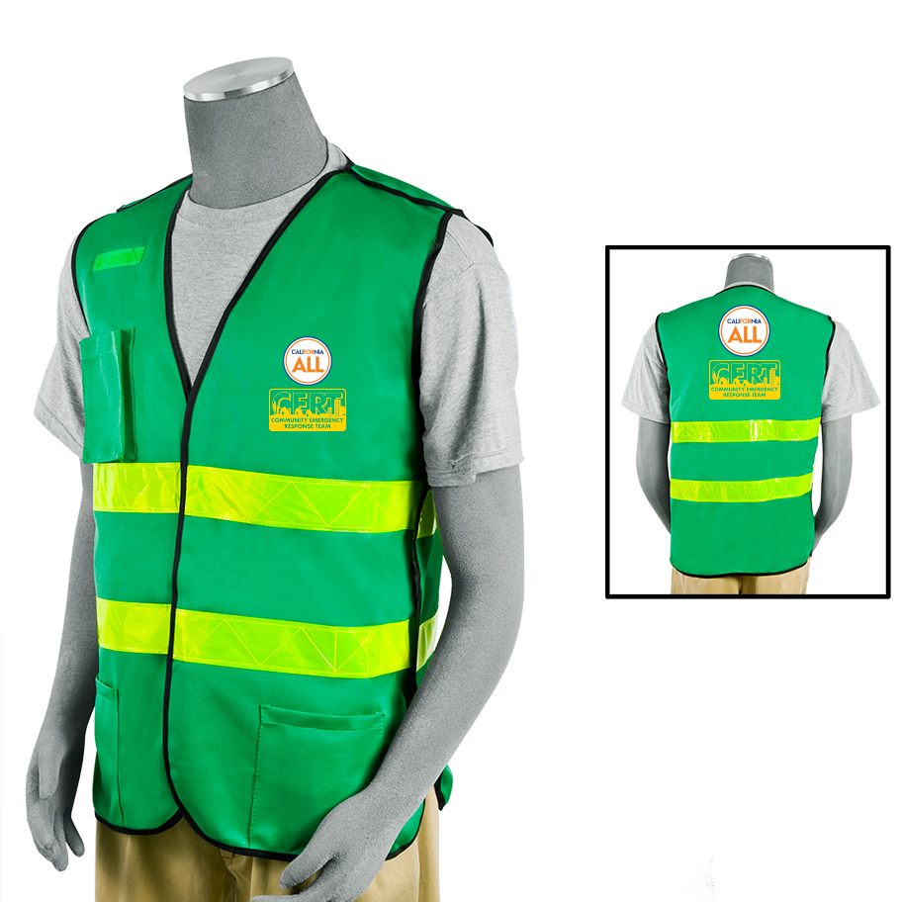
- DOJ Back Ground Check - Liability Insurance for non- CERT activities - 2,000 CERT Contacts must be documented - State approved Helmet and Vest - Track on MERIT/ App

Slide 3
Disaster Service Workers-

