Slide 1
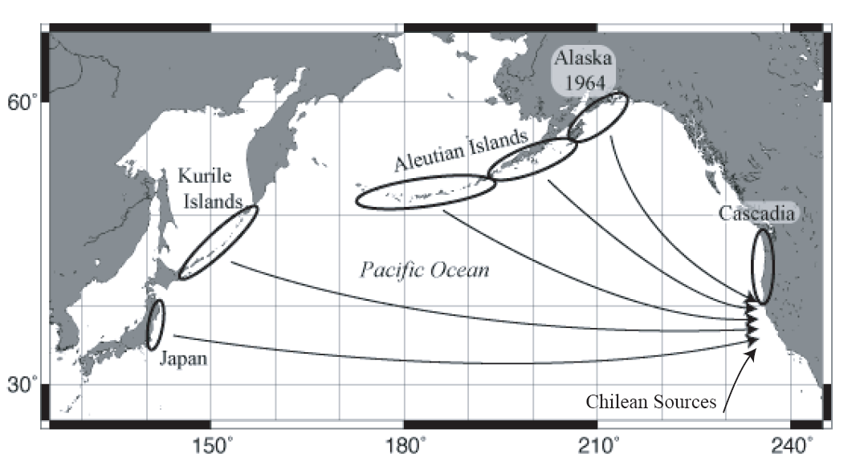
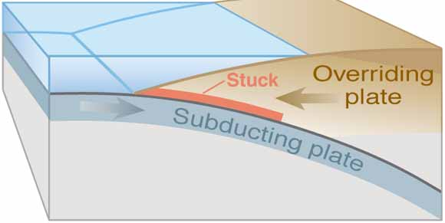
Distant Source Tsunamis
Kamchatka
CALIFORNIA
Columbia-Ecuador and
Izu-Bonin Mariana
Not felt
Tsunami will arrive in 5+ hours
Official Warnings – NTWC, NWS, State, County
Action – partial to full evacuations/keep people away
from water

Slide 2
Japan 2011
Distant Source Tsunami For California
Large tidal fluctuations, Crescent City 16 feet (largest surges at low tide)
Bay Area had 1 to 5 foot surges
Strong currents/debris in harbors
Potential dangerous tsunami conditions lasted for more than 24 hours
Statewide impacts: one fatality; two dozen harbors damaged; damages ~$100M

Slide 3
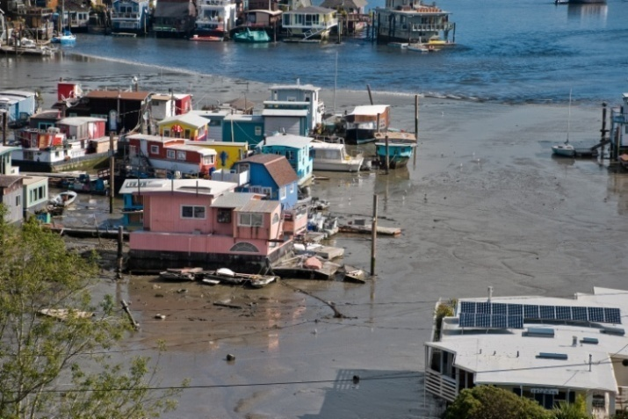
2011
Japan Tsunami in Marin County
Open coastline
strong currents in Bolinas
~ 3 feet
Inside north SF Bay
tsunami drawdown and bores
~ 1-4 feet

Slide 7
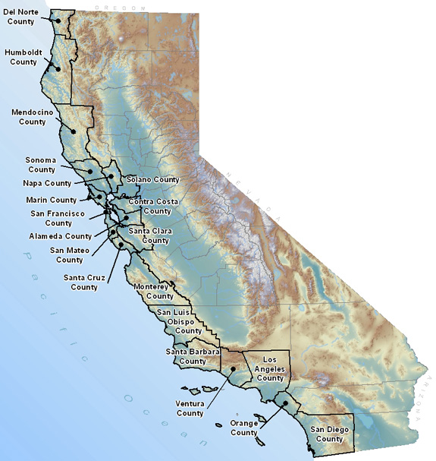
Tsunami Inundation Maps
Tsunami.ca.gov
MyHazards.caloes.ca.gov
TsunamiZone.org

Slide 8
Tsunami
Inundation Maps

Slide 9
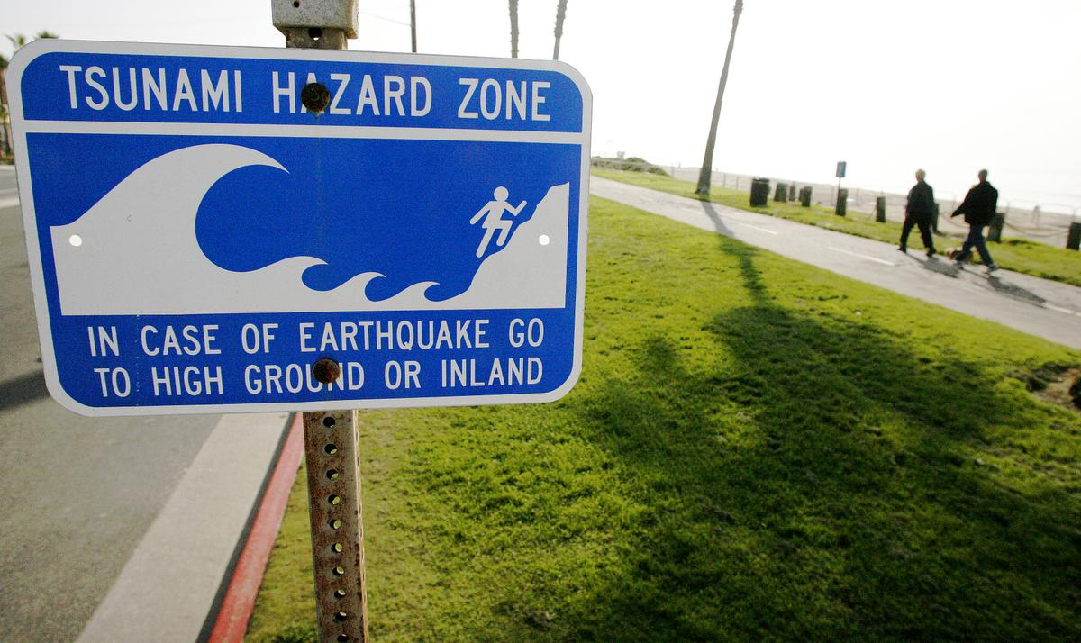
Local Source Tsunamis
Large Local Earthquake
No Official Warning
Strong and/or Long Shaking is the Warning
Tsunami can arrive within minutes
Evacuate out of Inundation Zone
Get to higher ground
Go inland
Do not return until you hear from officials
Sign Placement
Public education
Training
Know your Zone

Slide 10
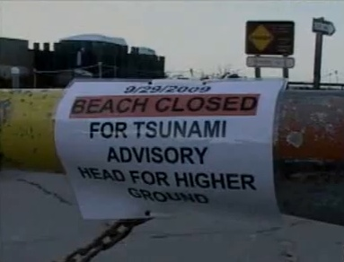
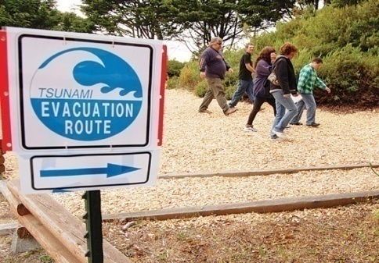
Distant Source Tsunami
Level of Response depends on event size
Official Warnings will be broadcast
Smaller events -
Keep people away from water
Larger events -
Partial to full evacuation

Slide 11
California has a history of damaging tsunamis which have resulted in loss of life.
At least 100 tsunamis have been recorded since 1800
13 caused significant damage
5 caused human casualties
1964 tsunami from the AK M9.2 EQ, killed 13 in CA
2011 tsunami from Japan M9.1 EQ, killed one person and
100 million in damage
The entire California coast is vulnerable –
everyone should be aware of tsunamis.
Large damaging tsunamis are not common events, but they can be catastrophic.
Notes:
California coastline is 1100 miles long
Home to 1 million, plus 10s of millions of annual visitors
At least 100 tsunamis have been recorded since 1800
13 caused damage
5 caused human casualties
1964 tsunami from the AK M9.2 EQ, killed 13

Slide 12
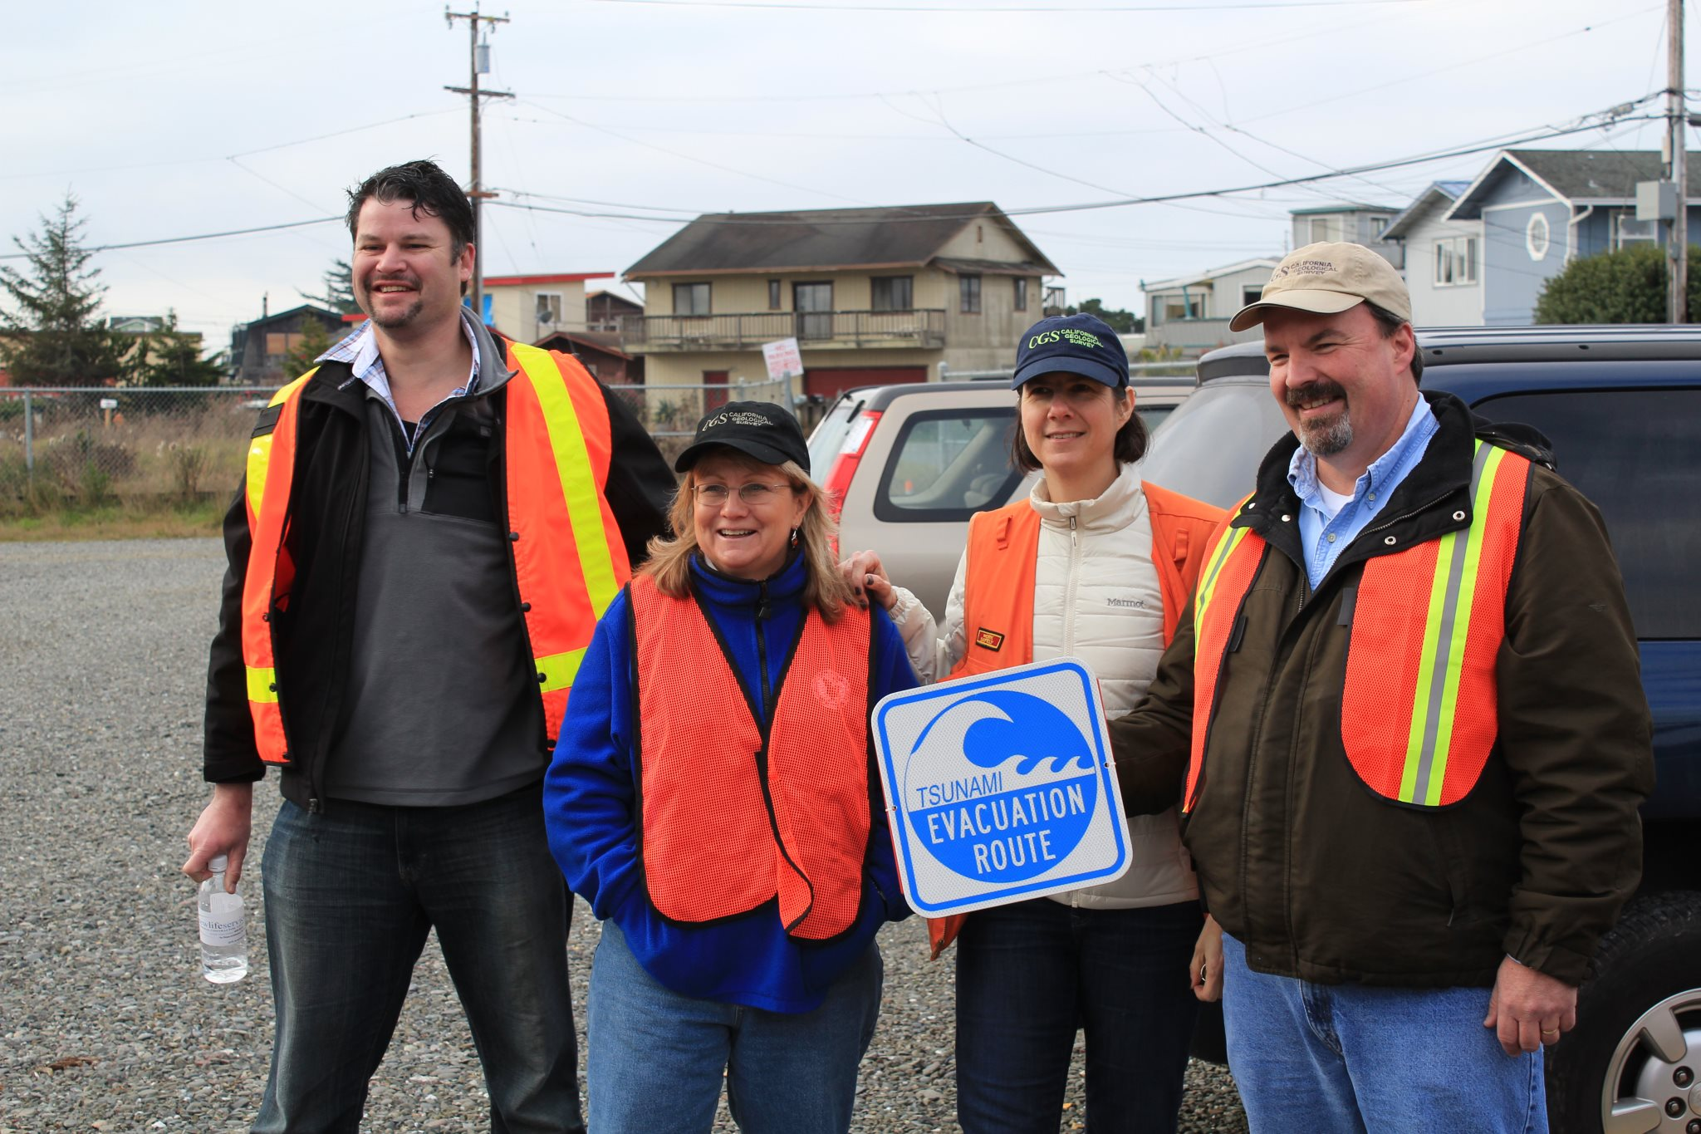
We are all in this together!

