Slide 1

Lessons Learned in GIS Collaboration and Preparedness from California
March 1, 2018
Phil Beilin
City of Walnut Creek
CA Earthquake Country Alliance Bay Area Workshop

Slide 2
Synopsis of Your Story
Workflows
Partnerships
Inter-operable data, tools
Actionable decision-making
Notes:
CA Earthquake Clearinghouse and its partners continue to make progress in developing workflows of data from the field to Operational Centers and other decision makers
What does your story mean to the broader community?
Successful data development and decision making require collaboration of multiple disciplines, levels of government and of levels of decision making process
The outcome of regular meetings with minutes, workshops, and trainings has resulted in successful workflows of data from the field to the decision maker and has been documented in our AARs

Slide 3
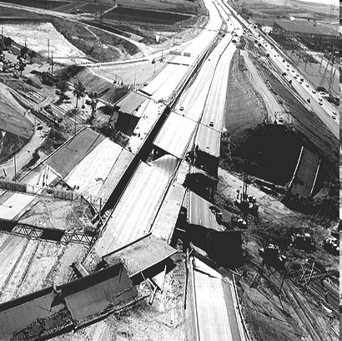

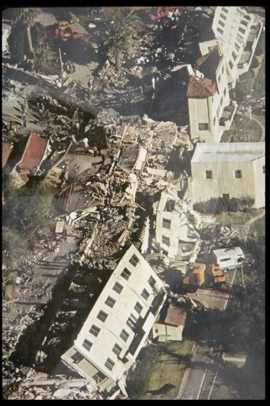
Origins of the Clearinghouse Concept
1st Clearinghouse called for by Gov. Ronald Reagan after 1971 San Fernando Earthquake—2017 is our 46 Year Anniversary!
Notes:
The origins of the clearinghouse are rooted in practicality – scientists and engineers responding to the 1971 San Fernando earthquake kept running into each other, and realized that it would make sense to coordinate about where they were going and what they were doing because they had similar interests and quite literally, could cover more ground and accomplish more if they worked together.
.
Clearinghouse partners are NOT:
First Responders
Emergency Responders
Policy making organization
We ARE primarily scientists and engineers
But, like emergency managers and responders, scientists and engineers are passionate about what they do, and are motivated to assist in response and recovery
Our volunteers are subject-matter experts:
Most are licensed professionals and/or researchers with advanced degrees
Many will have roots in the affected area, having contributed in building it the first place, these are the people who conduct geologic investigations and provide engineering design recommendations
Have in depth knowledge of the extent of local hazards and conditions
—in CA, licensed professional geologists and engineers work on state-funded critical use facilities permitted by Office of Statewide Health, Planning and Development (OSHPD) and Division of the State Architect. The California Geological Survey has conducted landslide corridor mapping for Caltrans and post-fire debris flow mapping for Cal FIRE. Our partner EERI funds researchers who also collaborate with local communities to develop policies and strategies to strengthen and improve performance of the built environment. The USGS and NASA have both developed custom products for agencies across the United State, and around the world.
Experience responding to numerous earthquakes brings deeper understanding and knowledge, and access to a wealth of expertise

Slide 4
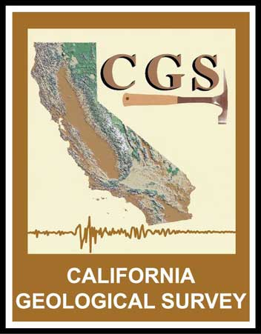




Managing Organizations
Chair: California Geological Survey (Permanent Lead Agency)
Vice Chair: Earthquake Engineering Research Institute
California Office of Emergency Services
U.S. Geological Survey
California Seismic Safety Commission
Notes:
In California, The state agency entrusted with administering the Clearinghouse mandate is the California Geological Survey. The CGS is the permeant lead, coordinating Clearinghouse agency. The USGS and EERI, are the two NEHRP managing organizations that oversee emergency response operations of the California Earthquake Clearinghouse (Clearinghouse). The two managing state agencies are Cal OES and California Geological Survey (CGS). And the Seismic Safety commission, who do not participate in Clearinghouse earthquake activations.

Slide 5



Clearinghouse Sub-Committees
IT Sub-Committee:
Chair: Phil Beilin (City of Walnut Creek)
Outreach Sub-Committee:
Chair: Paula Scalingi (Bay Area Center for Regional Disaster Resilience)
Overflight Sub-Committee:
Chair: Ken Hudnut (USGS)
Cal OES Air Coordination Group:
Derek Kantar
Notes:
In California, The state agency entrusted with administering the Clearinghouse mandate is the California Geological Survey. The CGS is the permeant lead, coordinating Clearinghouse agency. The USGS and EERI, are the two NEHRP managing organizations that oversee emergency response operations of the California Earthquake Clearinghouse (Clearinghouse). The two managing state agencies are Cal OES and California Geological Survey (CGS). And the Seismic Safety commission, who do not participate in Clearinghouse earthquake activations.

Slide 6
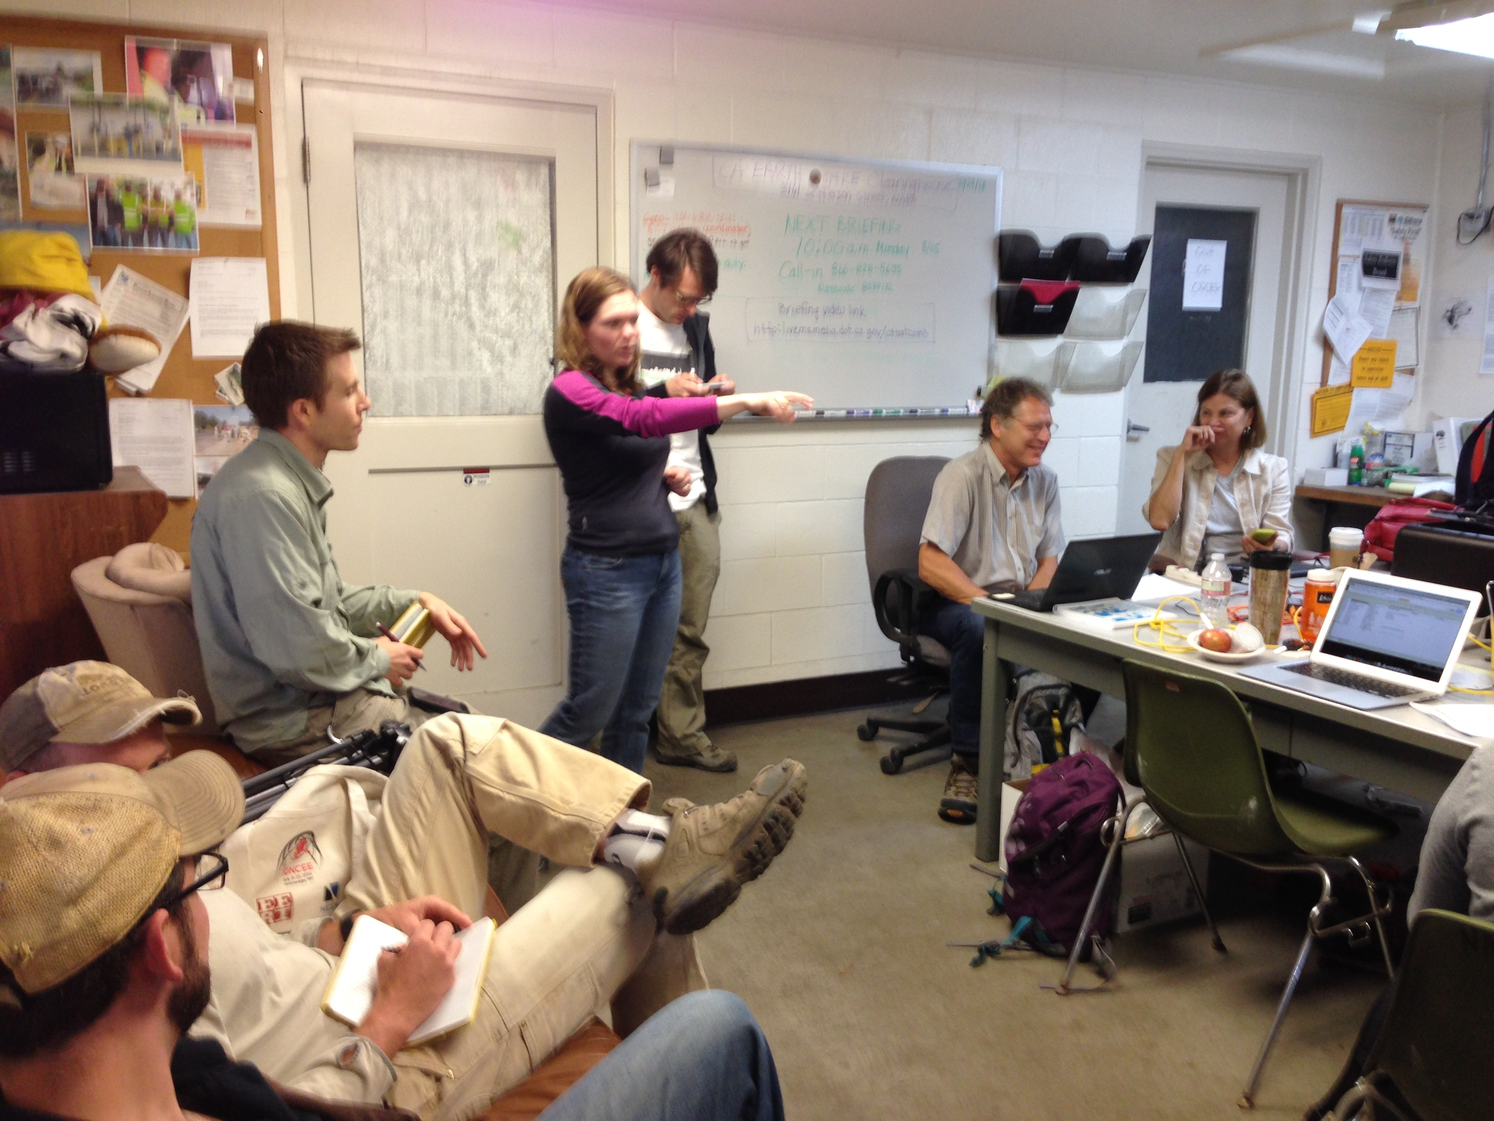
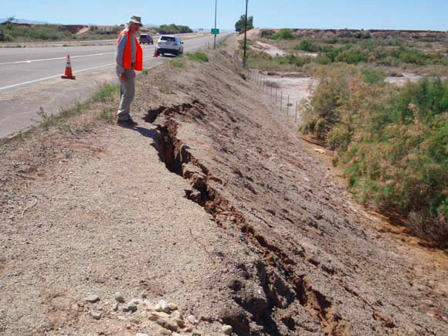
Clearinghouse Objectives
Facilitate field investigations by earth scientists, engineers and social scientists, who converge on the disaster site
Synthesize information for response agencies
Clearinghouse does not direct or control activities of participants
Facilitate Geospatial data sharing
Develop work flows for information sharing from planning through recovery
2014 S. Napa Earthquake, DR-4193 (photo A.Rosinski)
Nisqually, WA Clearinghouse, Feb. 2001
Notes:
The clearinghouse’s principal function is to be a forum for sharing information with the intent to provide Local, State, Federal, and Tribal disaster response managers, and the scientific and engineering communities, with prompt information on ground failure, structural damage, and other consequences from significant seismic events such as earthquakes and tsunamis.
Earthquake hazard, risk, and exposure, is different for every state, and can even vary WITHIN a single state, and appropriately, each clearinghouse will be configured differently, to reflect these unique conditions—it is NOT one-size fits all. But these are the functions the clearinghouse concept is intended to support. It:
Tracks fieldwork progress and seeks ways to minimize duplication of effort to extend limited resources and ENSURE DO NOT GET IN THE WAY OF RESPONSE AND LIFE SAFETY operations;
Provide limited liability coverage to volunteers who participate in a clearinghouse activation or exercise
In areas where access may be restricted we facilitate collecting perishable data through coordination with emergency management organizations and law enforcement;
Facilitate overflights;
Provide a forum for sharing information and conduct nightly briefings via meetings at a physical location (field office) and/or through a virtual clearinghouse
Organizing all the data and imagery, collected via personnel and organizations, using various technologies and applications, into actionable analysis, and ensuring that we are communicating clear uniform information
And notify disaster responders and emergency managers of crucial observations or earthquake impacts

Slide 7
Clearinghouse Exercise Successes
Federal Agencies:
10+
State and Local:
22+
Non-Governmental Organizations: 12+
Neighboring States and Jurisdictions: 12+
Academic and Research: 7+
Private Sector: 16+
9 EXERCISES

Slide 8



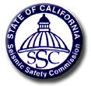











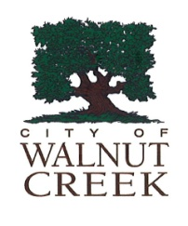





Coordination And Collaboration:
Information Sharing Between Multiple State, Federal, Local Organizations,
through XchangeCore connected applications
Emergency Function-10
Emergency Function-8
N. CA
Chapter
Notes:
Clearinghouse activations can include participation from a wide array of partners these are just a few.
Any organization interested in participating is welcome
Clearinghouse activations include participation from Federal, State and local government, law enforcement, fire, emergency management, public health, environmental protection, the military, public and non-governmental organizations, and private sector.
As saw with Napa earthquake (and I will get to that response in a minute), a variety of organizations will participate spontaneously, so we have to make sure that we can make participation possible to the widest number of organizations and capabilities

Slide 9
Information Sharing: Improving Situational Awareness and Decision Support
Mandate
Means to accomplish
mandate
DHS Science & Technology Directorate
XchangeCore
State of California
DHS FEMA NEHRP
National Earthquake Consortia
CA Earthquake Clearinghouse
Information Sharing & Technology Interoperability
Notes:
How do we go about actually doing that?
As I’ve outlined, a mandate to operate a clearinghouse for the express purpose of sharing critical information clearly exists, but, there exists no blueprint for how to accomplish that task, however we do have some tools at our disposal.
CA Clearinghouse is leveraging XchangeCore technology that is both free and open source, developed by the US Dept of Homeland security, to make it easier for more people to share critical information, and contribute their expertise in support of response and recovery efforts, increased situational awareness, and enhanced rapid hazard assessment.
The ability to securely share information, bi-directionally, between multiple applications and technologies, using a wide variety of formats, and all in real time, can improve response times, thus saving lives and minimizing damage and costly repairs, and ultimately speeding up response, recovery and community resilience.

Slide 10

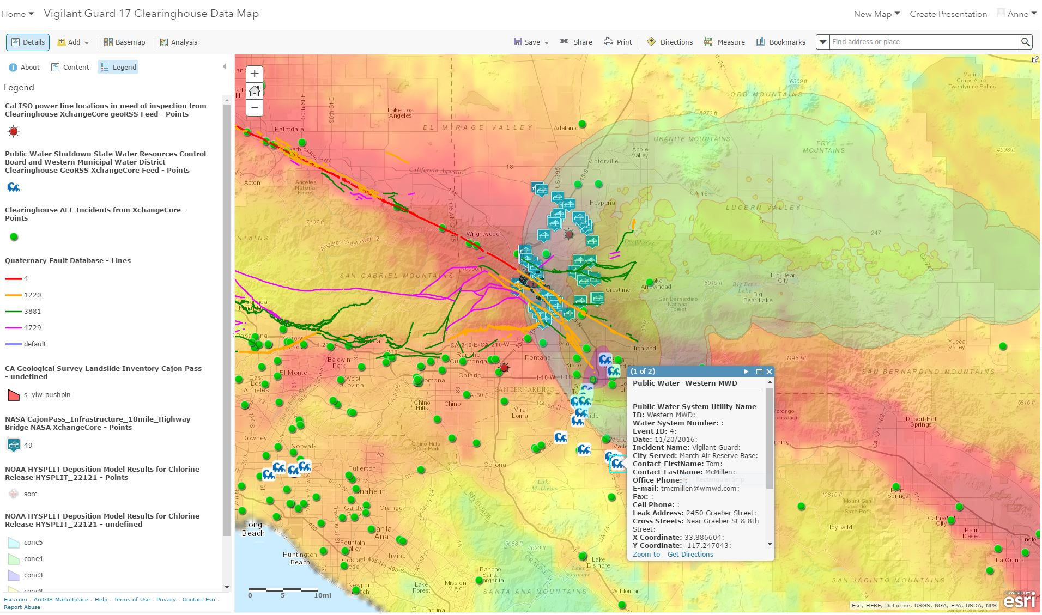






Each Organization Uses Their Own Application to Compose Data Into the Right View
Vigilant Guard 17 – Combining Data Provided By Multiple Response Organizations, And Shared Through The
California Earthquake Clearinghouse XchangeCore, For Enhanced Situational Awareness
Notes:
Ultimately, we are able to empower our partners to create their own custom decision support products for Improved Situational Awareness.
Enables Exchange: Transforms data into national standards
Assures Currency: Notifies all applications of new or updated data
Provides Security: Authenticates application to the XchangeCore Core
Delivers Collaboration: Two-way exchange among Whole Community diverse applications
Manages Content: Coordinates all Common Operational Data around a relevant incident so there is just one place to look for everything
No New End-User Software: No training, existing applications, DHS paid
Proven Experience, Available Now

Slide 11
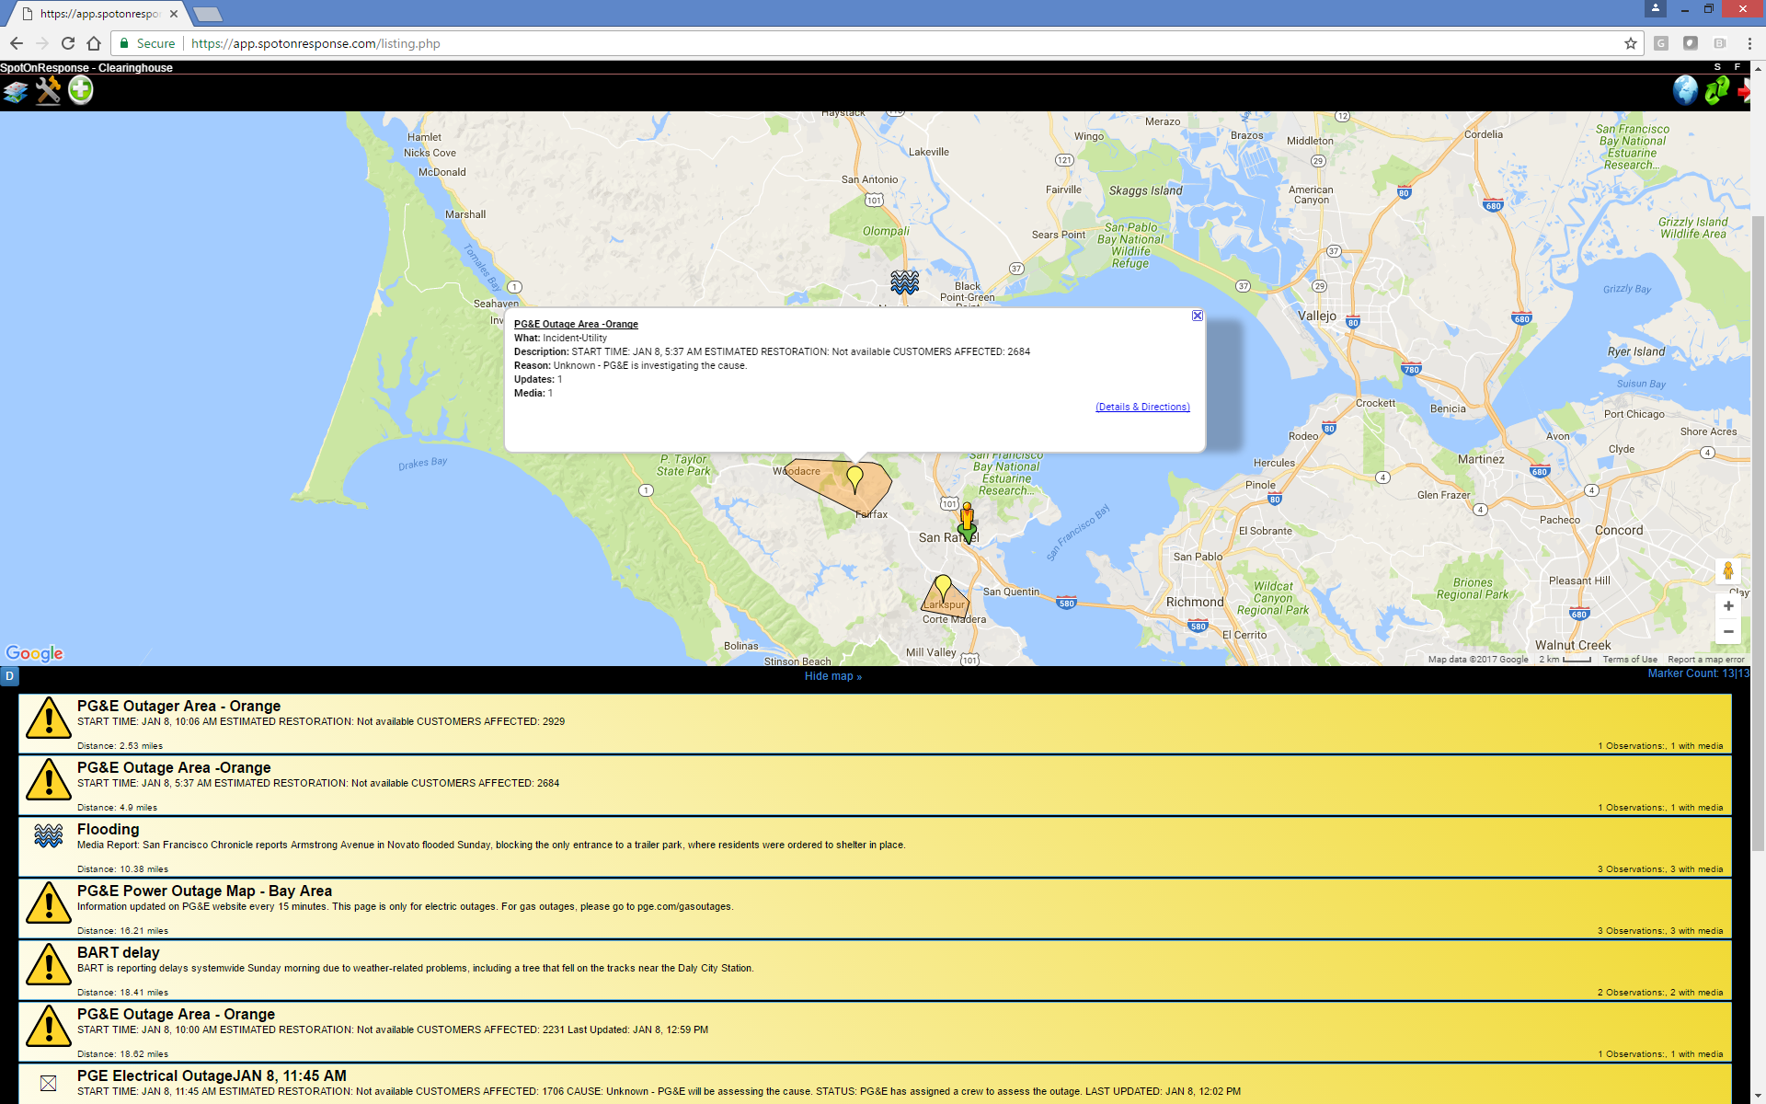
Clearinghouse Demonstrating Information Sharing System of Systems – January 2017 Winter Storm
PG&E Outage Information in SpotOnResponse

Slide 12
2017 CA FIRES Geospatial Data AAR Workshop
Pre-stage geospatial data locally
  (parcels, bldg. foot prints, vulnerable pop, CI)
Copy Incident / damage data locally from Cloud
Learn and bookmark authoritative sources of data
  CALOES, USGS, NOAA, CDPH, CALEPA
Continue to develop air coordination and imagery coordination

Slide 13
Criteria for Success
Develop centralized process to compile/share damage information
Participate in planning for Emergency Response exercises
Support development of workflows from field to EOC’s and above
Learn when and how to request geospatial data
Access to data before, during and after an incident

Slide 14
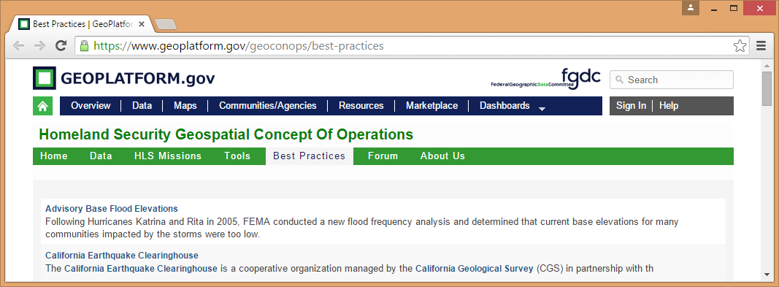
CA CLEARINGHOUSE RECOGNIZED BY
U.S. Department of Homeland Security as a GeoCONOPS Best Practice!
California Earthquake Clearinghouse
Sept. 22, 2015: “…a geospatial method, technique, capability or resource that provides superior support to the mission; and is used by the geospatial community as a benchmark for success”
Notes:
Efforts have been validated
CA Earthquake Clearinghouse has received national recognition for our information sharing efforts
The U.S. Department of Homeland Security, FEMA’s parent agency, supports the CA information-sharing effort
Other element that makes success for improving communication/planning:
High level of outreach and trainings the CA Clearinghouse provides. Allowing participants an ability to become familiar with the other types of data, analysis and connections possible. They can practice with the data. This has been a weakness pointed out by the Rand Corporation’s paper on U.S. Natural Hazard Responses in other parts of the World. Both the XchangeCore and CA Clearinghouse provide regular trainings leading up to and including in exercises.
---------------
USGS-Open Geospatial Consortium recommendation for technology interoperability include Clearinghouse efforts with XchangeCore
Video
https://www.dropbox.com/s/9lm0fvp0v24q9tl/USGS%20OGC%20IA.mp4?dl=0
powerpoint
https://portal.opengeospatial.org/files/?artifact_id=60411

Slide 15
Take Away Message
Essential Elements of Information
Multiple levels of government
Multiple disciplines
Webinars, lessons learned, stakeholder engagement
CA Earthquake CH AAR
Symbology Standards
“Data” person - decision maker relationship
Training, Exercises
Notes:
Successful data collaboration involves developing workflows; standards of damage assessment for EEIs; understanding what decision makers want to see; development of relationships between data and decision makers
Take a look at our CAEQCH website AAR reports for Ardent Sentry 2015; Cascadia Earthquake 2017; and Vigilant Guard 2017.
Give us a call to hold a webinar with your group; we are very interested in how you work with your stakeholders; what you are focusing on and your lessons learned
Develop focused workflows of information from the field to the decision based on multi-agency/level of government/multi-disciplinary collaboration and train on those workflows.

Slide 16
Thank you!
Phil Beilin
City of Walnut Creek GIS Coordinator, CA GIS Council Chair 2017; NAPSG R9 co-Coordinator
http://californiaeqclearinghouse.org or pbeilin@walnut-creek.org

Slide 17
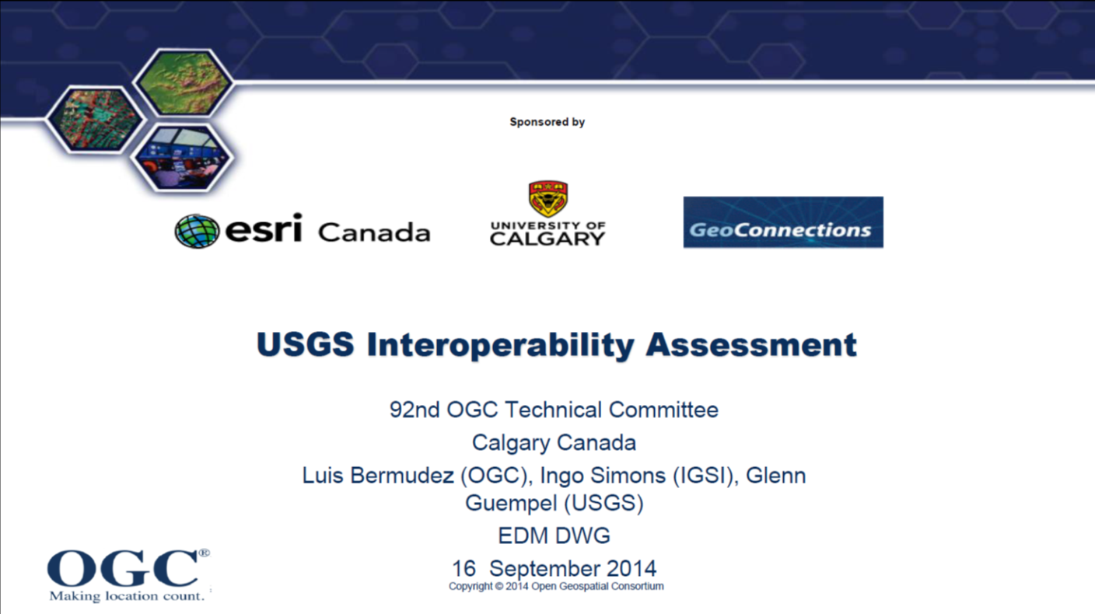
USGS-Open Geospatial Consortium recommendation for technology interoperability with XchangeCore
Common Operational Data - Multiple data sources and formats orchestrated and made available to other applications
Make data intelligent so can use for analysis so responders can make informed decisions
Support sharing on both geospatial and NON-geospatial information
https://www.youtube.com/watch?v=m5GvWUeTFvE&feature=youtu.be

